Slide 1
FMC API Programming with Python
Security Orchestration, Automation, and Response
June 16, 2020

Slide 2
Agenda
Introduction
Day 1: Modules 1 - 5
Day 2: Modules 6, 7
Day 3: Modules 8, 9

Slide 3
Introduction

Slide 4
Welcome!
Welcome to FMC API Programming with Python
About your instructor: Richard Clendenning
I was an instructor with Sourcefire when Cisco purchased Sourcefire seven years ago
I began programming the FMC API when it first came out, to help automate operations for customers
The course is very hands on, because we learn best by doing!
This class is informal – please interrupt to ask questions at any time
Programming is intensive work, so we will take frequent breaks

Slide 5
Course Lab Exercises
The course is divided into modules
Each module has a lecture portion and a lab portion with lab exercises
I will show you the concepts for the module, and then you will perform the lab exercises.

Slide 6
Course Prerequisites
Knowledge of the Cisco FMC, access policies and rules, and objects is required
No knowledge of Python or programming is required
The participant’s machine must have the following installed:
A browser
Postman
Visual Studio Code
Python 3.x

Slide 7
Module 1 Introduction to the FMC REST API

Slide 8
Introduction to the FMC API
FMC: Firepower Management Center
REST: Representational State Transfer
API: Application Programming Interface
The FMC REST API allows FMC operations to be performed by sending HTTP requests to the FMC.
It provides an alternative to the FMC GUI
Users can issue individual API requests using a web client to request information or perform an operation.
Users can write scripts or applications to perform many FMC operations very quickly.
Use of the API can also minimize configuration errors by avoiding manual input of configurations.

Slide 9
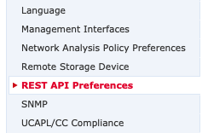

Enabling the FMC REST API
The FMC API must be enabled for it to be used.
System>Configuration>REST API Preferences

Slide 10
FMC API Explorer
The FMC API Explorer provides a limited interface for the REST API as well as giving a view of the abilities of the REST API.
The FMC API Explorer follows the OpenAPI Specification (OAS)
Use separate accounts for the API
Location: https://<FmcHostName>/api/api-explorer

Slide 11
REST API Basics
A REST API request has four parts:
Endpoint: https://10.1.2.3/api/fmc_config/v1/domain/e276abec-e0f2-11e3-8169-6d9ed49b625f/policy/accesspolicies
Method: GET, POST, PUT, DELETE
Headers: "Content-Type: application/json"
Body (or data)

Slide 12
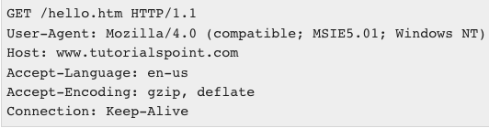
GET Request Example
Method
Endpoint
{
Headers
Body
(no body for a GET)
https://www.tutorialspoint.com/http/http_requests.htm

Slide 13
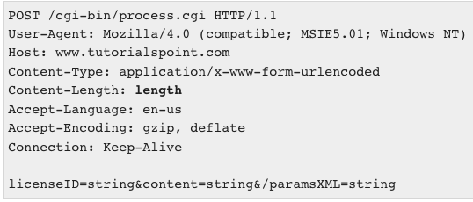
POST Request Example
Method
Endpoint
{
Headers
Body
https://www.tutorialspoint.com/http/http_requests.htm

Slide 14
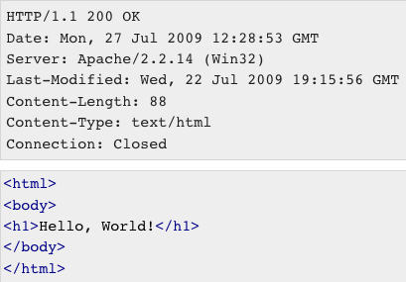
REST API Responses
Status Code
Headers
Body
https://www.tutorialspoint.com/http/http_responses.htm

Slide 15
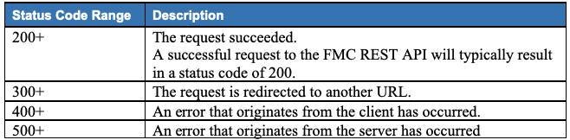
REST API Response Status Codes

Slide 16
REST API Authentication
The FMC API uses Token Authentication
You request a token by sending the username and password
The FMC responds with an access token and a refresh token
You use the access token in all future API requests
The access token expires in 30 minutes
The refresh token can be used to request a new access token
Up to three times, then you need to request a new access token using username and password

Slide 17
Module 1 Lab
See the course Lab Guide for the Module 1 Exercises
The steps you are to perform are always numbered
You will:
Log into the FMC GUI and see that the REST API is enabled
Log into the API Explorer and GET the access policies

Slide 18
Module 2: JSON

Slide 19
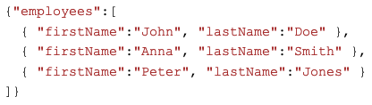
JSON
JSON is a structured data format
Unstructured data: The three employees are John Doe, Anna Smith, and Peter Jones.
Structured data (JSON):
https://www.w3schools.com/JS/js_json_xml.asp

Slide 20
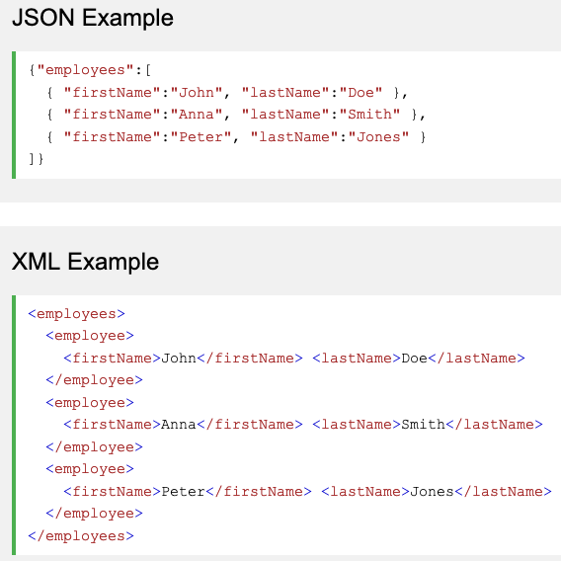
JSON vs XML
https://www.w3schools.com/JS/js_json_xml.asp

Slide 21
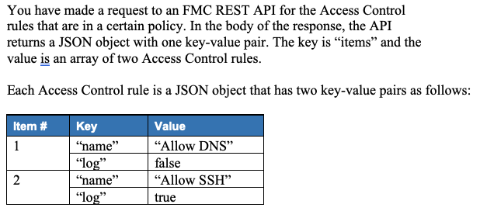
Module 2 Lab: JSON

Slide 22
Module 3: API Explorer In Depth

Slide 23
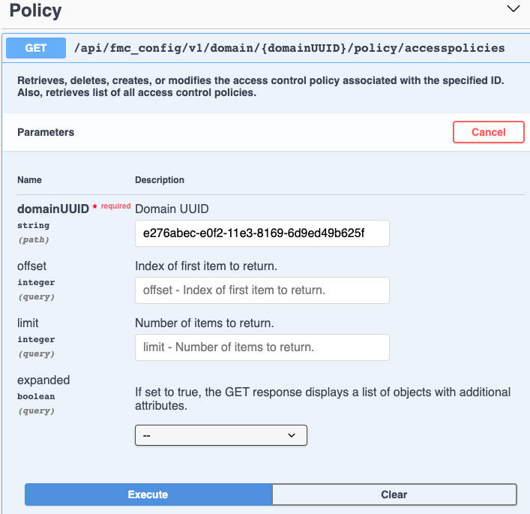
Module 3: API Explorer in Depth

Slide 24
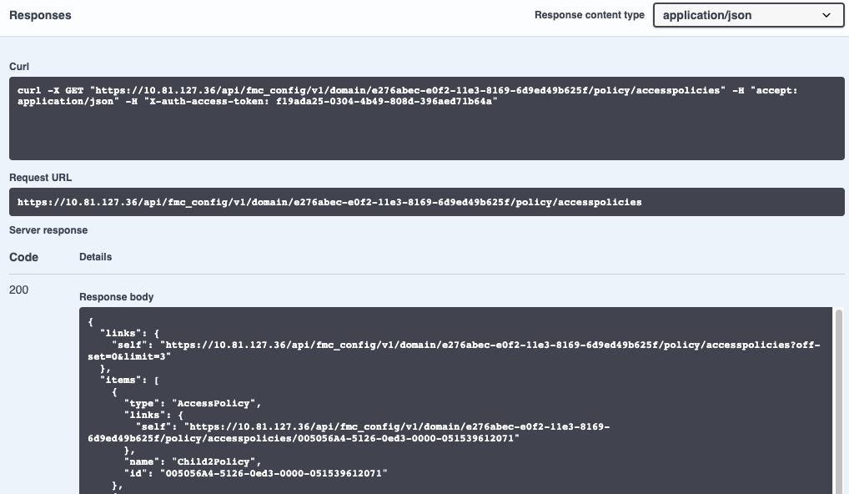
API Response
API Request

Slide 25
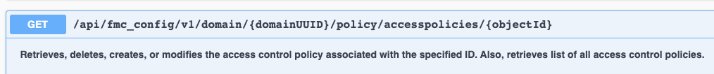
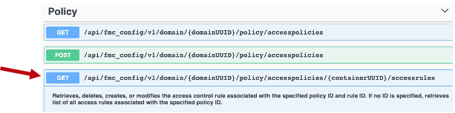
Module 3 Lab: API Explorer
In this lab you will GET all access policies, copy the id from one of those policies, and then GET that particular access policy.
You will then get the access rules for that policy.

Slide 26
Module 4: Postman

Slide 27
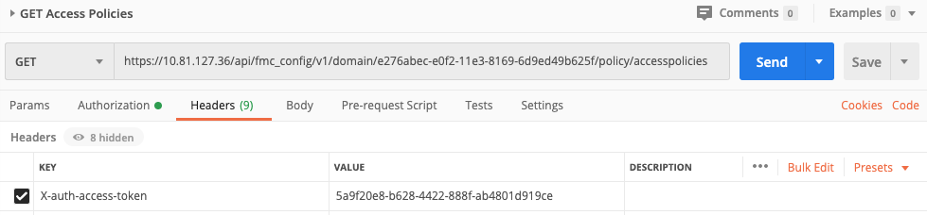
Module 4: Postman
Postman is a software development tool that allows us to test calls to APIs.
Select a method and enter the URL
Configure parameters, authorization, headers, and body
Send

Slide 28
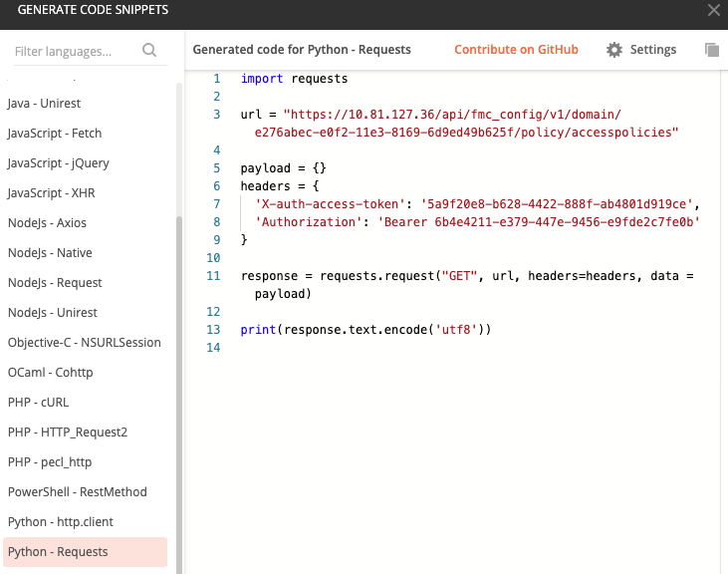
Postman Code Snippets
Postman generates code snippets in many languages
The code snippet at the right was generated for the request on the previous slide

Slide 29
Module 4 Lab: Postman
In this lab you will:
Create a GET request in Postman to GET an FMC access token.
Use the access token to GET the access policies
GET a particular access policy

Slide 30
Module 5: Introduction to Python

Slide 31
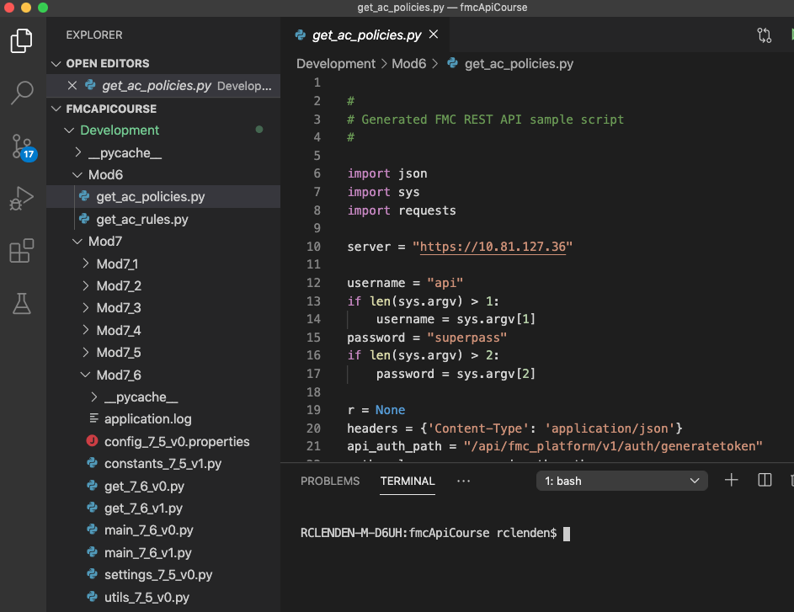
Visual Studio Code
VS Code is a popular environment for Python development

Slide 32
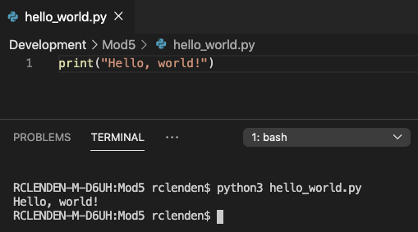
Module 5 Lab: First Python Program in VS Code
Open VS Code
Install the Python extension
Create Development/Mod5 folders
Create hello_world.py
Execute
If you also have Python2 installed, you may need to specify python3

Slide 33
Switch to Lab
Perform Labs 5.1 and 5.2
It is important to make sure you have done the following before we continue:
VS Code running
Python extension installed
Successfully executed hello_world.py

Slide 34


Python Basics: Comments
Comments
https://www.w3schools.com/python/python_comments.asp

Slide 35



Python Basics: Variables
Variables
https://www.w3schools.com/python/python_variables.asp

Slide 36
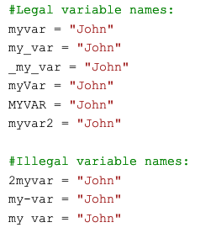
Python Basics: Variable Names
https://www.w3schools.com/python/python_variables.asp

Slide 37


Using Print to Output Variables
https://www.w3schools.com/python/python_variables.asp

Slide 38
Python Basics: Data Types
Data types
String x = ‘Hello’
Numeric x = 5
List x = [‘banana’, ‘orange’, ‘apple’]
Dictionary x = {‘first_name’: ‘Bob’, ‘last_name’: ‘Smith’}
Boolean x = true
Getting the data type: type(x)
Gives string, int, list, dict, bool
https://www.w3schools.com/python/python_syntax.asp

Slide 39


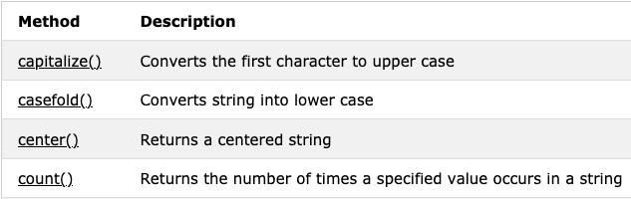
Python Basics: String Methods
At the bottom of the Python Strings page there are many String methods listed:
https://www.w3schools.com/python/python_strings.asp

Slide 40
Python Basics: More String Methods
At the bottom of the Python Strings page there are many String methods listed:
https://www.w3schools.com/python/python_strings.asp

Slide 41

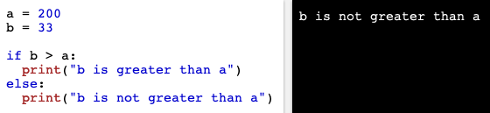
Python Basics: Booleans
https://www.w3schools.com/python/python_booleans.asp

Slide 42
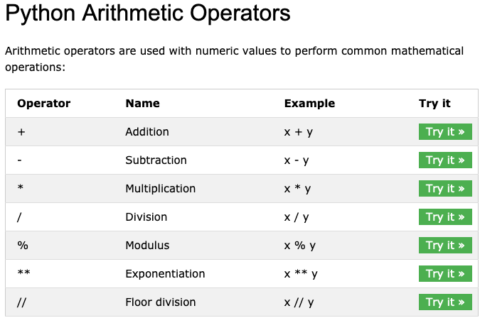
https://www.w3schools.com/python/python_operators.asp

Slide 43
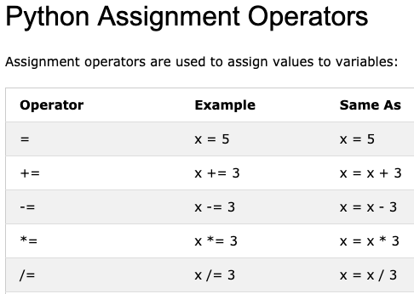
https://www.w3schools.com/python/python_operators.asp

Slide 44


Python Basics: Arithmetic Operator Examples
https://www.w3schools.com/python/python_booleans.asp

Slide 45
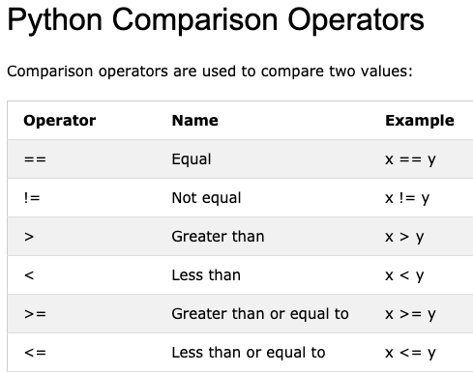
https://www.w3schools.com/python/python_operators.asp

Slide 46
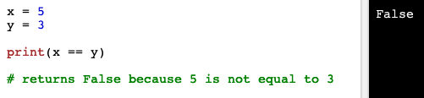
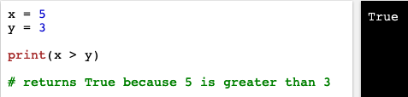
Python Basics: Comparison Operator Examples
https://www.w3schools.com/python/python_operators.asp

Slide 47
Switch to Lab
Perform Labs in section 5.3.1
Python Variables
Data Types
Strings
Operators

Slide 48

Python Basics: Lists
0
1
2
index
https://www.w3schools.com/python/python_syntax.asp

Slide 49
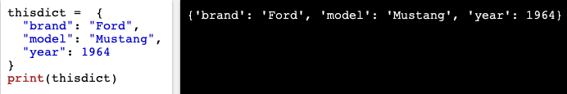
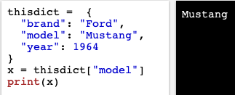
Python Basics: Dictionaries
https://www.w3schools.com/python/python_syntax.asp

Slide 50
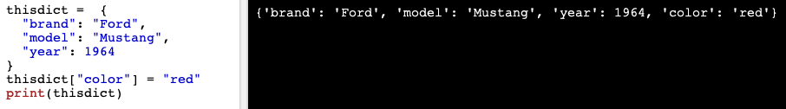
Adding an Item to a Dictionary
https://www.w3schools.com/python/python_syntax.asp

Slide 51
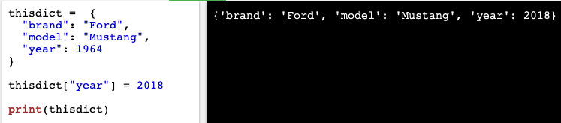
Python Basics: Changing a Dictionary Value
https://www.w3schools.com/python/python_syntax.asp

Slide 52
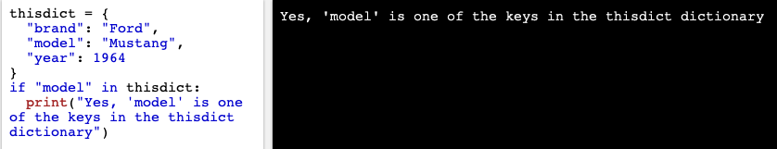
Checking if a key is in a dictionary
https://www.w3schools.com/python/python_syntax.asp

Slide 53

Python if ... else
https://www.w3schools.com/python/python_syntax.asp

Slide 54
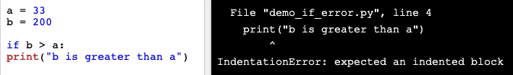
Indentation Defines Scope
https://www.w3schools.com/python/python_syntax.asp

Slide 55
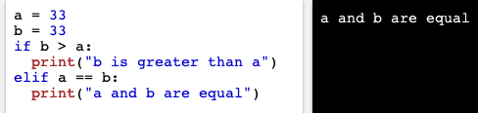
Elif
https://www.w3schools.com/python/python_syntax.asp

Slide 56
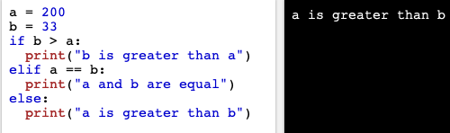
Else
https://www.w3schools.com/python/python_syntax.asp

Slide 57
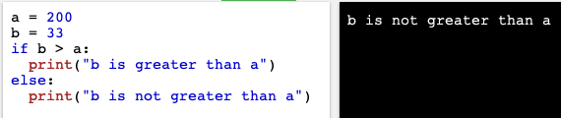
Else without Elif
https://www.w3schools.com/python/python_syntax.asp

Slide 58

For Loops
https://www.w3schools.com/python/python_for_loops.asp

Slide 59
Switch to Lab
Perform Labs in section 5.3.2
Lists
Dictionaries
If … Else
For Loops

Slide 60

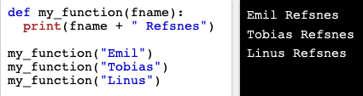
Functions
https://www.w3schools.com/python/python_functions.asp

Slide 61
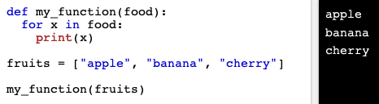
Passing a List to a Function
https://www.w3schools.com/python/python_functions.asp

Slide 62
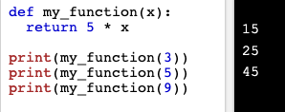
Returning values from a function
https://www.w3schools.com/python/python_functions.asp

Slide 63
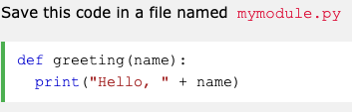

Python Modules
https://www.w3schools.com/python/python_modules.asp

Slide 64
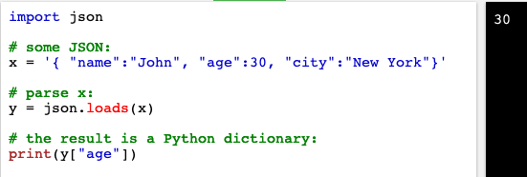
Converting a JSON String to a Python Dictionary
https://www.w3schools.com/python/python_syntax.asp

Slide 65
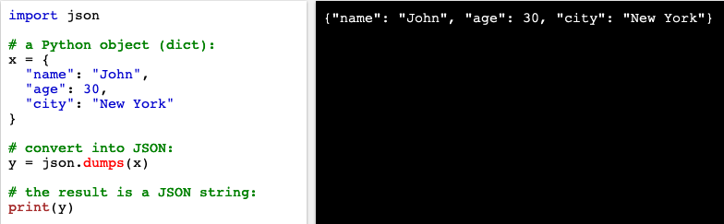
Converting a Python Dictionary to a JSON String
https://www.w3schools.com/python/python_syntax.asp

Slide 66
Python JSON
https://www.w3schools.com/python/python_syntax.asp

Slide 67
Switch to Lab
Perform Labs in section 5.3.3
Functions
JSON Conversions

Slide 68
Python PIP
PIP is a package manager for Python modules
It is included in Python (for version 3.4 and later)
A module is a Python code library you can include in your project
We will need to install requests
pip install requests
https://www.w3schools.com/python/python_syntax.asp

Slide 69
Switch to Lab
Install Python Requests

Slide 70
Module 6: API Requests with Python

Slide 71
Module 6: API Requests with Python
In this module you will:
Obtain sample code from the API Explorer to issue a GET request for Access Control Policies
Configure that code for our FMC
Turn off SSL Verification
Execute the program to receive a list of access control policies
BIG MOMENT – OUR FIRST API CALL USING PYTHON!

Slide 72
Switch to Lab
Perform Labs in sections 6.1 to 6.4
You should obtain a list of access policies

Slide 73
Module 6 continued: API Requests with Python
We continue on to:
Execute the program by supplying our username and password at the command line
Eliminate the InsecureRequestWarnings
Request the access control rules in an access policy

Slide 74
Switch to Lab
Perform Labs in sections 6.5 to 6.7
You should obtain a list of access rules in a specified access control policy

Slide 75
Module 7: Building a Code Framework

Slide 76
Module 7: Building a Code Framework
We do not want a separate program for each operation we want to perform
We want one program that can perform many operations
We need to build a framework, using two principles:
Avoid duplication of code
Separate code that changes from code that does not change

Slide 77
7.1 Avoiding Code Duplication through Functions
GET requests are virtually the same
They only differ by their endpoint
We can re-use code by defining the code as a function
Then we can call the function and pass to it:
The FMC information
The endpoint

Slide 78
7.1 Creating a Reusable Module
A Python module is just a file with code in it
We can create a function from our GET code
We can create a Python program in another file that calls the get_object() function
This second file will be our main, or client, file.

Slide 79
7.2 Parsing the Output
We really just want the name and ID from the output

Slide 80
7.3 Working with Properties, Printing, and Constants
The fmc_info should be stored in a static properties file, not as part of our code.
Reading the properties file should be abstracted away from our main program.
We will create a settings.py module for this
The code for printing the item list is duplicated
We can create a function for this, and we can abstract it into a utils module
The endpoints that are constants can be placed in a constants.py module

Slide 81
7.4 Module 7.4 has been eliminated
This slide is intentionally blank

Slide 82
7.5 Module 7.5 has been eliminated

Slide 83
7.6 Logging
Logging is critical in helping us understand what has happened when something has gone wrong, so we can troubleshoot it.

Slide 84
Module 8:

Slide 85
Module 8.1: GETting Objects
We can now use the objects/networks endpoint to get the FMC’s networks.

Slide 86
Module 8.2: POSTing an Object
We will create a POST module, from code obtained from the Legacy Explorer.
We will then copy example data from the API Explorer and use it in the main program to send to the POST function.
We will verify that the network is posted, both in the FMC and in the application log.

Slide 87
Module 8.3: POSTing Objects in Bulk
In 8_3_1, we will put networks, hosts, and ranges in a CSV file.
We will read the file, and iterate through it to POST each object.
Main_8_3_v1.py will POST the objects from a CSV file.

Slide 88
Module 8.3: POSTing Groups in Bulk
In 8_3_2, we will create a CSV file for network groups.
We will read the file, and iterate through it to POST each group.
Main_8_3_v2.py will POST the groups from a CSV file.

Slide 89
Module 8.4: Command Line Arguments
In 8_4, we will specify the operation to perform at the command line.

Slide 90
Wrap up

Slide 91
Wrap-up
Questions??
Thank you!!

Slide 92
Notes:
Thank you.

